Slide 1
Introduction to B…..Basic MATLAB
Chi Sing Leung

Slide 2
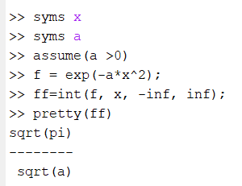
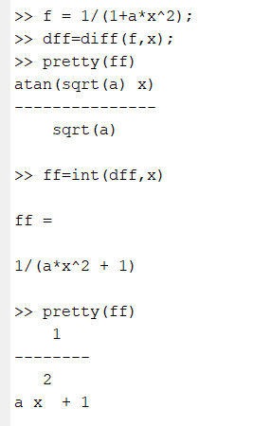
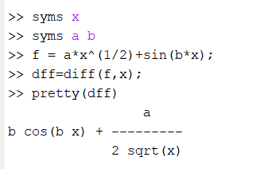
What is Matlab?
MATLAB® is a programming platform designed specifically for engineers and scientists. 编程平台
Analyze data (vector向量, matrix(矩阵), or semi-structured data(半结构化数据))
Develop algorithms开发算法
Create models and applications
With symbolic toolbox符号工具箱, we can analytically perform differentiation, integration, etc

Slide 3
Where to get it ?
Method 1: Install(安装) in your computer.
https://www.cityu.edu.hk/csc/deptweb/facilities/central-sw-tah.htm
Go to CityU’s MATLAB Portal.
Click “Sign in to get started” in the Get MATLAB and Simulink section.
Sign in with your CityU EID and password.
Create a MathWorks account using your CityU email address.
Download the installer from MathWorks website.
Run the installer.
In the installer, select Log in with a MathWorks Account and follow the online instructions.
When prompted to do so, select the Academic – Total Headcount license labeled Individual.
Select the products to download and install.
After downloading and installing your products, keep the Activate MATLAB checkbox selected and click Next.
When asked to provide a user name, verify that the displayed user name is correct. Continue with the process until activation is complete.

Slide 4

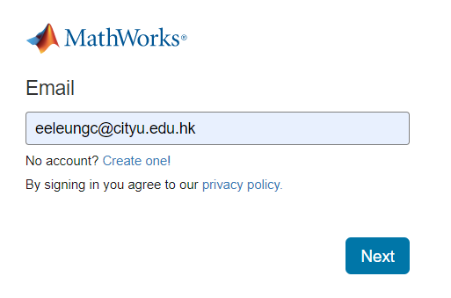
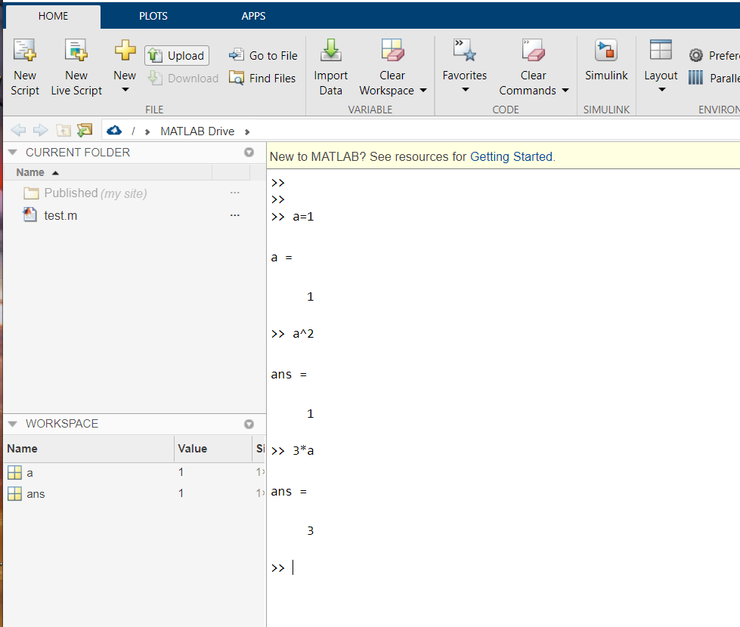
Where to get it ?
Method 2: Use online matlab: (open an account first)
https://www.mathworks.com/products/matlab-online.html

Slide 5
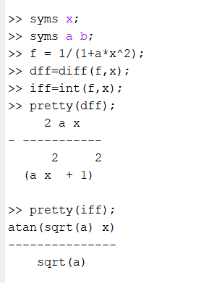
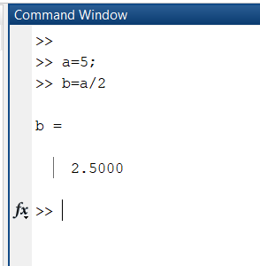
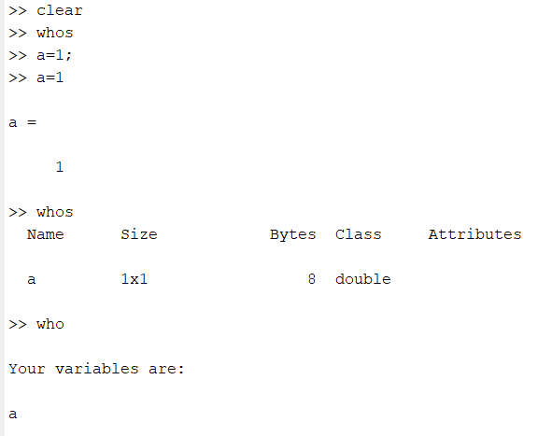
Get start
Interactive command (use as calculator)(交互式命令)
syms x;
syms a b;
f=1/(1+a*x^2);
dff=diff(f,x);
idff=int(f,x);
2. If you don’t type semicolon(分号) after a command, then run-time result appears in the MATLAB Command Window
Matlab will store your variables and results in the current sessions
In the current session, you can use “who” or “whos” to check your variables in the environment.

Slide 6
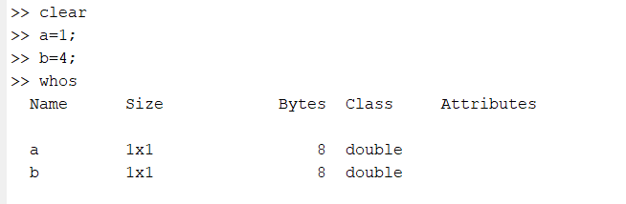
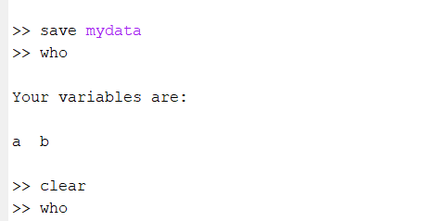
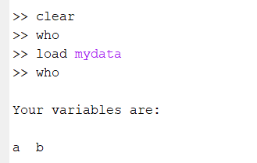

Get start
However, if you close the session, all your results will lose
You can save your results by
using: save filename
You can load your data file by using:
load filename

Slide 7
MATLAB Variable Names
Variable names ARE case sensitive(区分大小写)
Variable names can contain up to 63 characters
Variable names must start with a letter followed by letters字母, digits数字, and underscores下划线.
There are some special variables: (do not use them)
ans Default variable默认变量 name for results
pi Value of π
eps Smallest incremental number递增数
inf Infinity无穷
NaN Not a number e.g. 0/0

Slide 8
MATLAB Variable
Creating MATLAB variables
variable name = a value (or an expression)
For example,
x=3; a constant
x=y+2; an expression
x=sin(y); sin is a matlab bulilt-in function, where y is the input argument for the function.
Overwriting variable
Once a variable has been created, it can be reassigned. In addition, if you do not wish to see the intermediate results, you can suppress the numerical output by putting a semicolon (;) at the end of the line.
>> t = 5;
>> t = t+1
t = 6

Slide 9
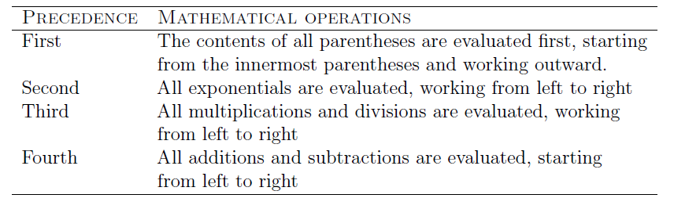
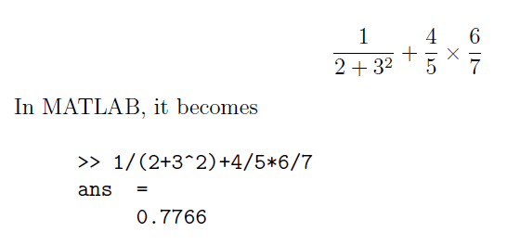
Hierarchy of arithmetic operations
The order in which MATLAB performs arithmetic operations is exactly that taught in high school algebra courses.
1/(2+3^2)+4/5*6/7

Slide 10
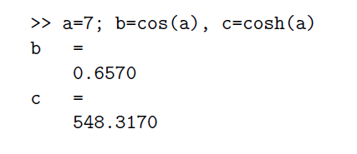
Entering multiple statements per line
We can enter a number of statements or commands in a line
a=7; b=cos(a), c=sin(a)

Slide 11
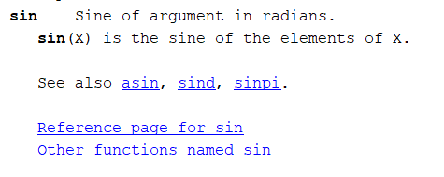
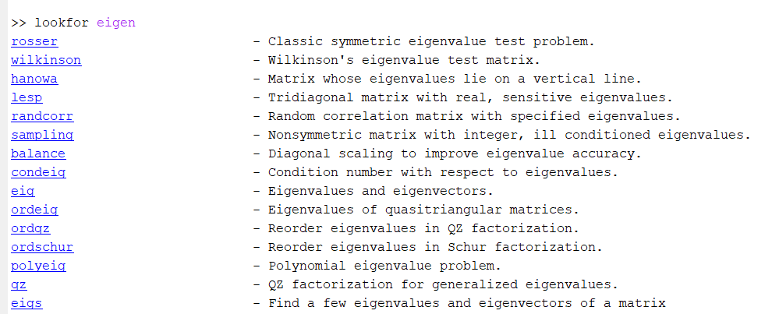
Built in Help
If we do not how to use a function, we can type
>>help sin
If we do not the exact function name, we can use
>>lookfor eigen
Or you can help matlab webpage or matlab help button

Slide 12
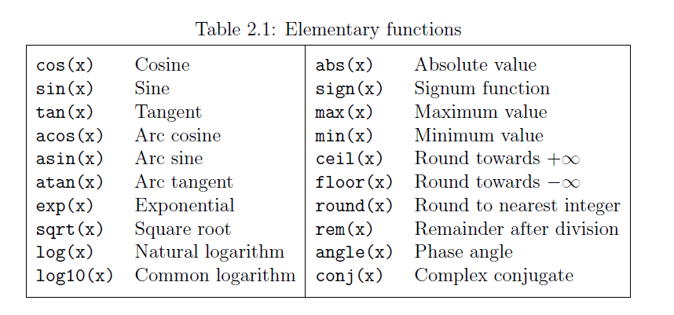
Built in function
Matlab has many built-in functions.
Many of them can operate vector or matlab data.
But before you use it, it is better to use “help” to check the details.
a=5; x=2;y=8;
y=exp(-a)*sin(x)+10*sqrt(y);
Youwill get
y = 28.2904

Slide 13


Array in matlab
To create an array with four elements in a single row, separate the elements with either a comma (,) or a space.
a = [4 6 9 8 9 12];
Refer to an element in an array
a(2)
Indices in array are starting from 1.

Slide 14
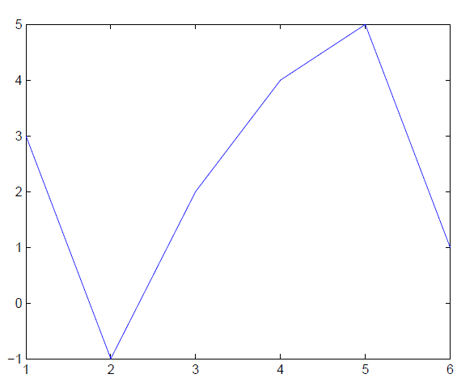
Simple plot your data
x and y are both row arrays or column arrays of the same length.
plot(x,y) to plot data
x = [1, 2, 3, 4, 5, 6];
y = [3, -1, 2, 4, 5, 1];
plot(x,y)

Slide 15
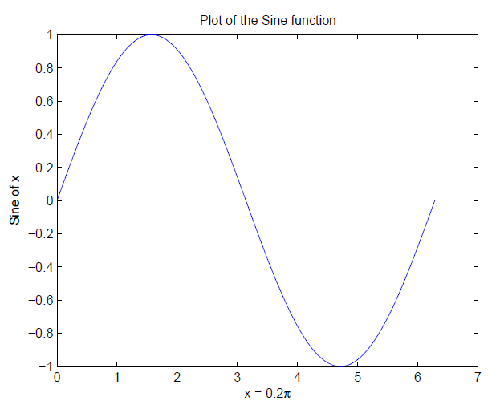
Adding titles, axis labels, and annotations
x = 0:pi/100:2*pi;
y = sin(x);
plot(x,y);
Notes:
0:pi/100:2*pi yields an array that the value starts at 0, takes steps (or increments) of pi/100, stops when *pi is reached.
The function “sin” will be applied to all element of the array
xlabel('x = 0:2\pi')
ylabel('Sine of x')
title('Plot of the Sine function')

Slide 16
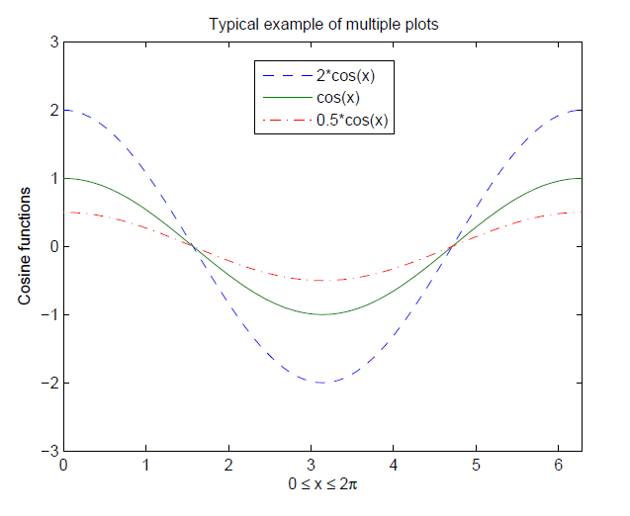
Multi-data in a plot
x = 0:pi/100:2*pi;
y1 = 2*cos(x);
y2 = cos(x);
y3 = 0.5*cos(x);
plot(x,y1,'--',x,y2,'-',x,y3,':')
xlabel('0 \leq x \leq 2\pi')
ylabel('Cosine functions')
legend('2*cos(x)','cos(x)','0.5*cos(x)')
title('Typical example of multiple plots')
axis([0 2*pi -3 3])

Slide 17
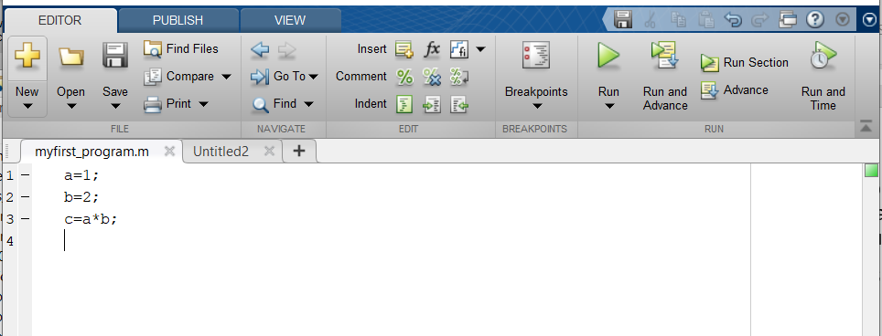
Matlab Script
In some situations, you need to solve a problem by using many commands. If you type the commands in the command window, you cannot reuse them and debug your works.
Use the MATLAB editor to create a file: File ->New ->M-file.
You can edit (type) the commands in a matlab script file (***.m) in editor window.
You can run your file by two ways
a. In the command window, type the filename of your m file.
b. Press the run button in the editor window

Slide 18
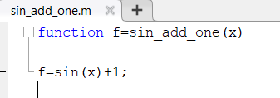
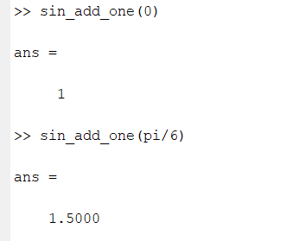
M-File functions
Functions are programs (or routines) that accept input arguments and return output arguments. Each Matlab function has its own area of workspace, separated from the MATLAB base workspace.
Usually, the local variables in a function do not affect the values of variables in the MATLAB base workspace,
The first line of a function starts with the keyword function. It gives the function name and order of arguments.
There are one output argument and one input argument.
After we save the file in the current directory, we use it
You can run your file by two ways
a. In the command window, type the filename of your m file.
b. Press the run button in the editor window

Slide 19
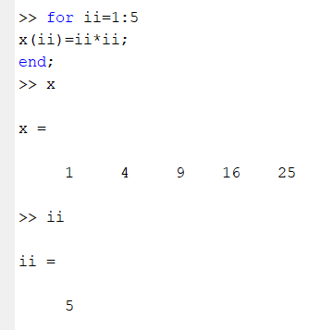
For loop
In the for ... end loop, the execution of a command is repeated at a predetermined number of times. The syntax is
for variable = expression
statements
end
for ii=1:5
x(ii)=ii*ii
end
Execute the statements 5 times. ii is from 1 to 5 .

Slide 20
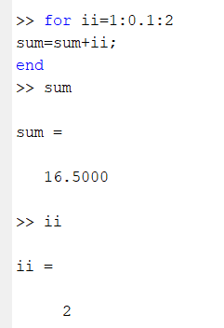
For loop
ii is from 1 to 2. each time, ii increment by 0.1.
In this case, you cannot use ii as index for an array

Slide 21
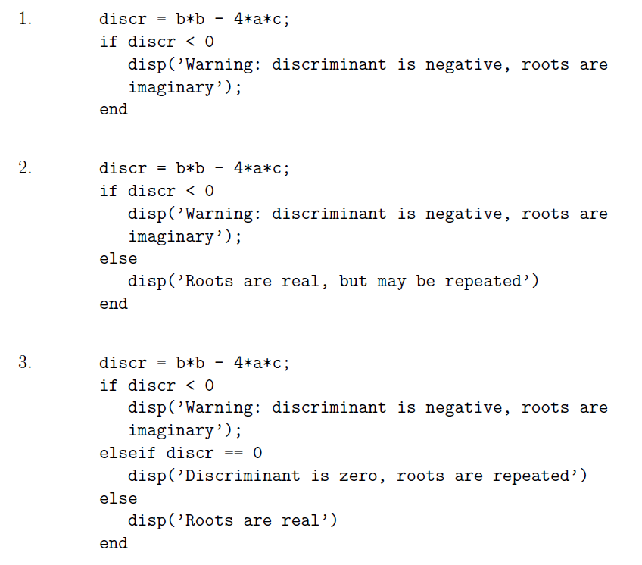
Control flow
The ``if...end'' structure
Three structures
1. if ... end
2. if ... else ... End
3. if ... elseif ... else ... end
If the condition OK, then execute the statements
You can run your file by two ways
a. In the command window, type the filename of your m file.
b. Press the run button in the editor window

Slide 22
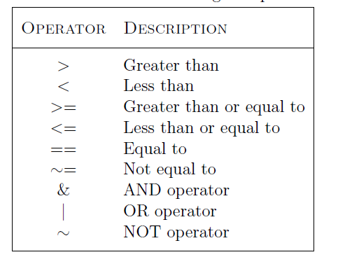
Relational and logical operators
A relational operator compares two numbers by determining whether a comparison is true or false.

Slide 23
Relational and logical operators
A relational operator compares two numbers by determining whether a comparison is true or false.

